Slide 1




Handwriting
Helper
By Group 3: Annie Stocks, Ashley Maurer, Payton Moore, Jonathan Eason, Liliana Remillard
Notes:
lily

Slide 2
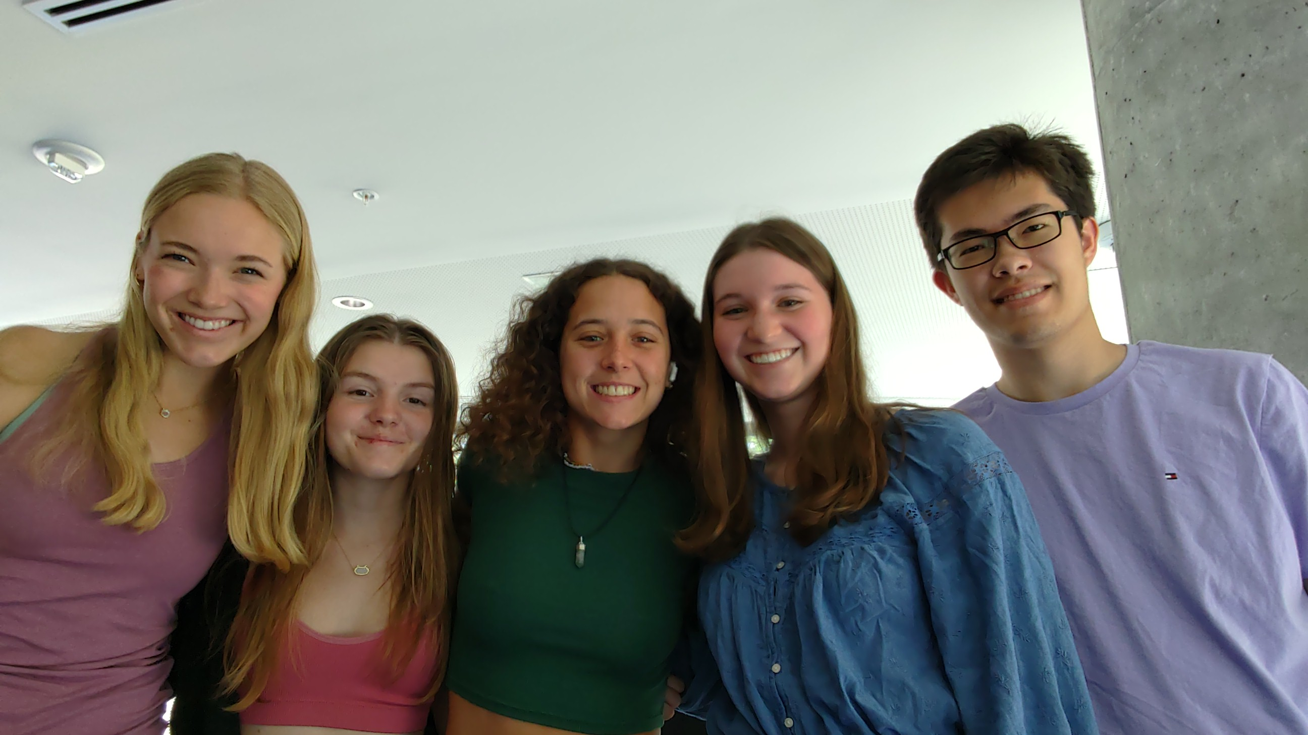
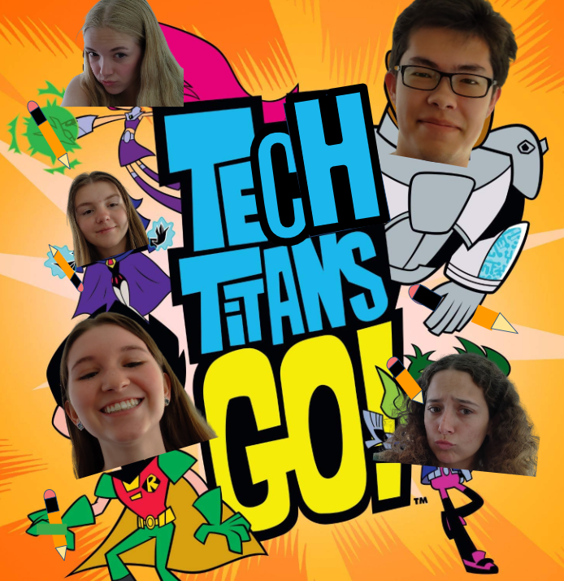

The Tech Titans!
Left to right: Payton Moore, Annie Stocks Natalias, Liliana Remillard, Ashley Maurer, Jonathan Eason
Notes:
lily

Slide 3
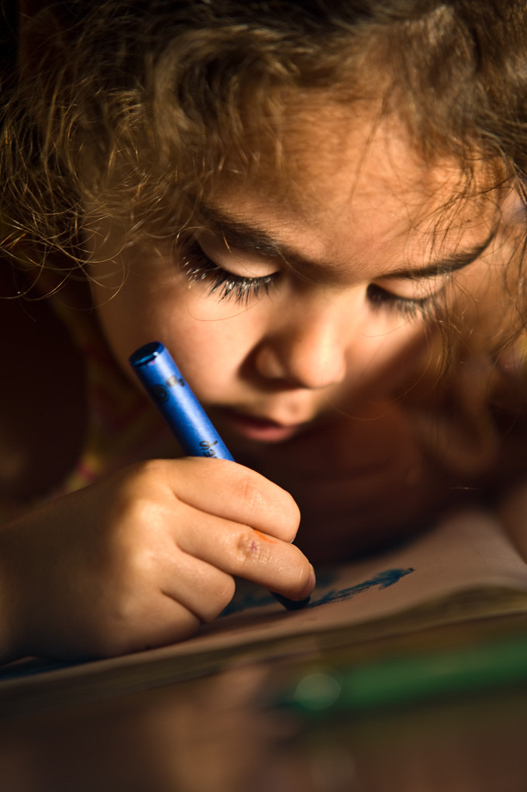
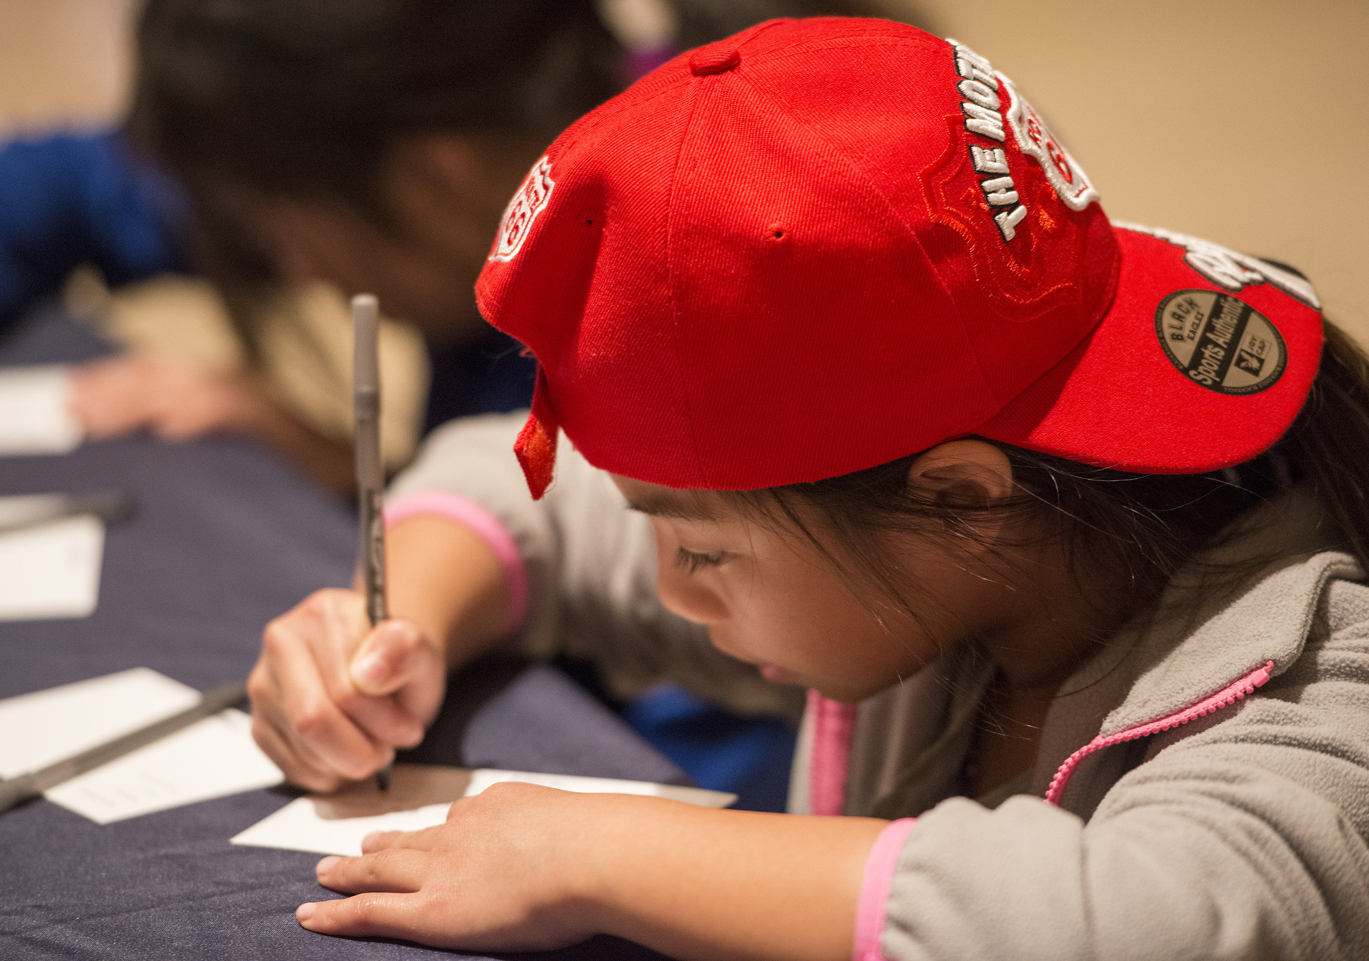
Human-Centered
User Needs
We strive to help young kids learn to write correctly in the classroom!
"Creative Child" by Jose Mediavilla is marked with Public Domain Mark 1.0. To view the terms, visit https://creativecommons.org/publicdomain/mark/1.0//?ref=openverse.
"DIG14026_074" by LBJLibraryNow is marked with Public Domain Mark 1.0. To view the terms, visit https://creativecommons.org/publicdomain/mark/1.0/?ref=openverse.
Notes:
lily

Slide 4

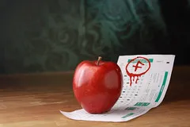
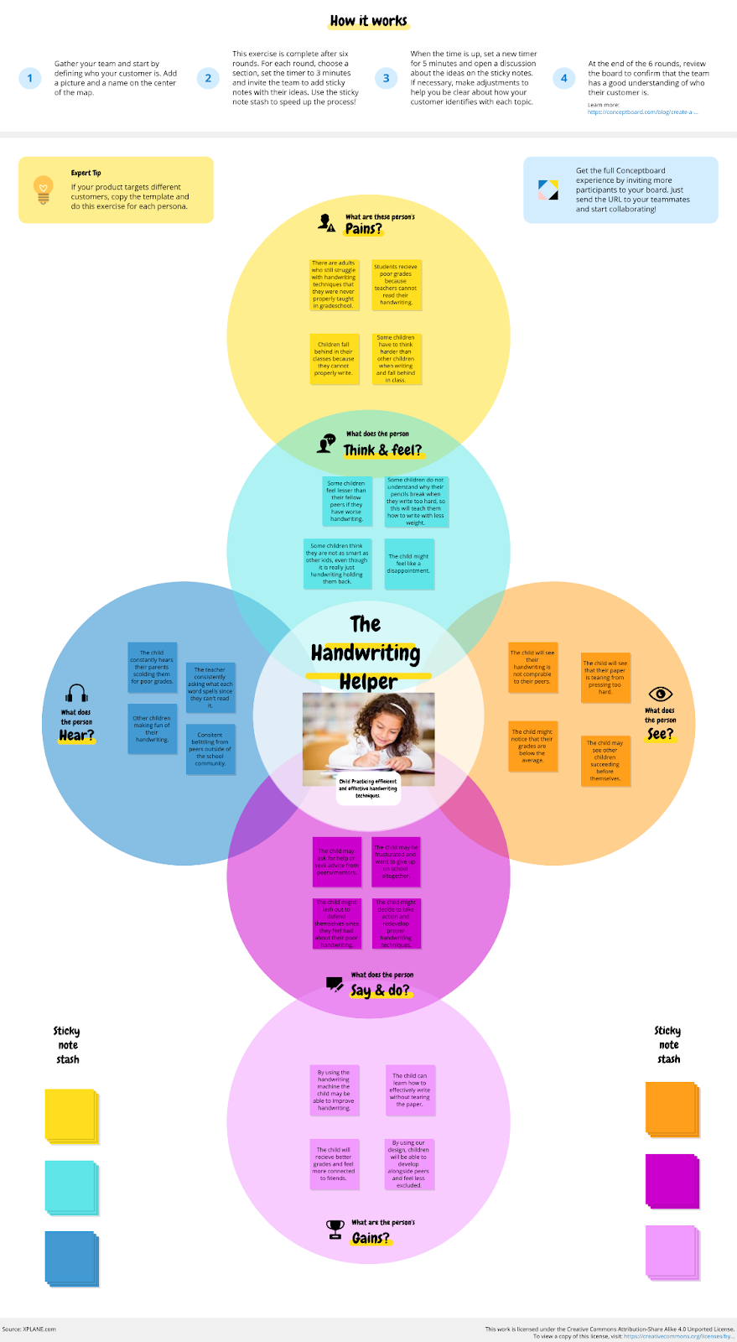
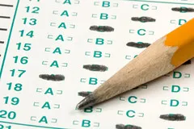

User Empathy Map
Pains
Struggle with a lifelong skill
Poor grades
Fall behind in class
Assignments take more effort
"_MG_2511" by Naive Photography is licensed under CC BY-NC-ND 2.0. To view a copy of this license, visit https://creativecommons.org/licenses/by-nc-nd/2.0/?ref=openverse.
Gains
A+
Help improve handwriting overall
Write without tearing the paper
Better grades and connection to peers
"Long Before the Third Grade Test" by wecometolearn is licensed under CC BY 2.0. To view a copy of this license, visit https://creativecommons.org/licenses/by/2.0/?ref=openverse.
Notes:
payton

Slide 5
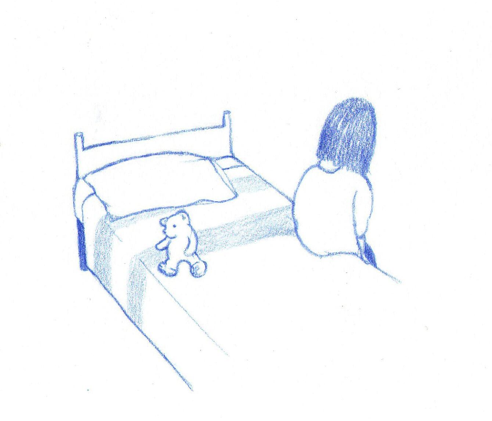
User Empathy Map
Think/Feel
Feel lesser than peers
Don't understand why pencils break
Feel like a disappointment
Feel not as intelligent
"A sad lonely child sits on her bed, anxiety, illustration" is licensed under CC BY-NC 4.0. To view a copy of this license, visit https://creativecommons.org/licenses/by-nc/4.0/?ref=openverse.
Say/Do
Ask for help from peers/ teachers
Frustrated students
Aids in practice of their handwriting in the classroom
"Creative Child" by Jose Mediavilla is marked with Public Domain Mark 1.0. To view the terms, visit https://creativecommons.org/publicdomain/mark/1.0//?ref=openverse.
Notes:
payton

Slide 6
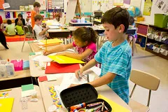
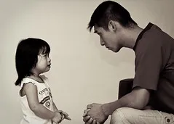
User Empathy Map
See
Handwriting differences
Torn paper
Low grades
Other children succeeding while they fail
"second grade writing class" by woodleywonderworks is licensed under CC BY 2.0. To view a copy of this license, visit https://creativecommons.org/licenses/by/2.0/?ref=openverse.
Hear
Parents scolding them for poor grades
Teachers asking about handwriting
Insults from other children
Insults from peers
"1-Jpeg-dennis-sharon-January 20, 2009-85 mm" by Dr.J.S is licensed under CC BY-NC-ND 2.0. To view a copy of this license, visit https://creativecommons.org/licenses/by-nd-nc/2.0/jp/?ref=openverse.
Notes:
payton

Slide 7




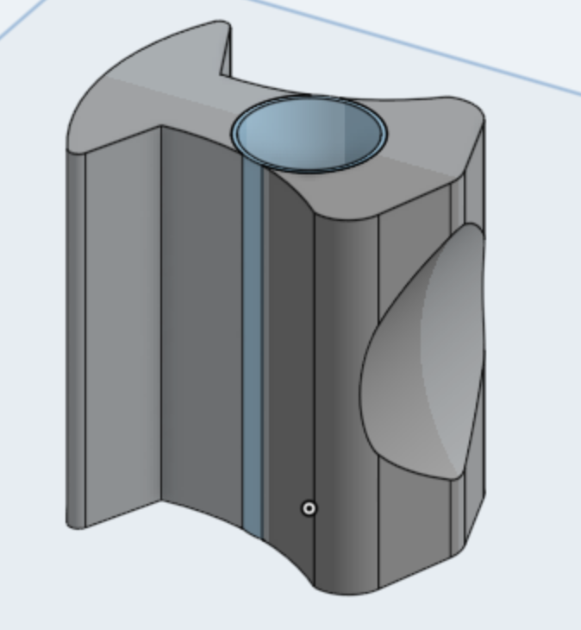

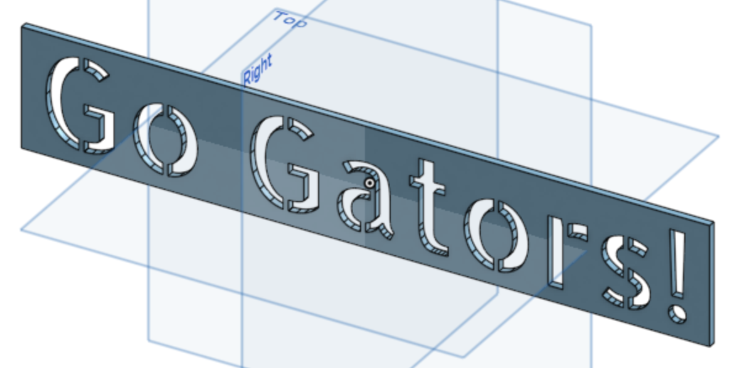
HUMAN-CENTERED CONSIDERATIONS
Pencil Grip
Templates
Pressure Sensors
Lateral Quadrupod Grip
Practice Stencils:
"Go Gators!" And "there"
Corrects Writing Techniques
Koziatek, S. M., & Powell, N. J. (2003). Pencil Grips, legibility, and speed of fourth-graders’ writing in cursive. The American Journal of Occupational Therapy, 57(3), 284–288. https://doi.org/10.5014/ajot.57.3.284
(G. Moore, personal communication, March 15, 2023)
Notes:
payton

Slide 8
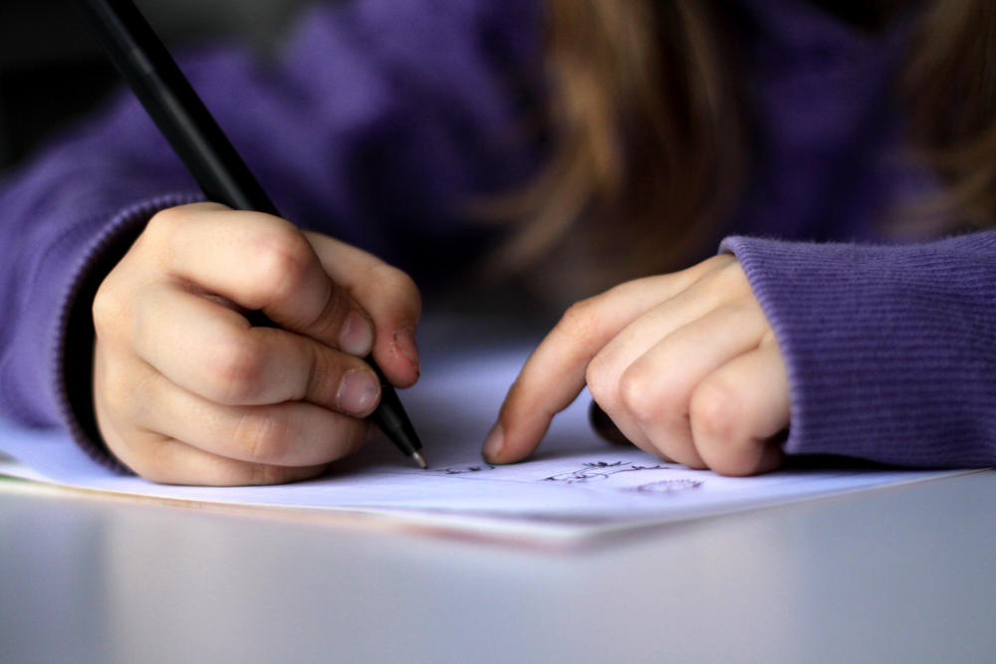
Background Research
Children's struggles with handwriting and using too much pressure.
Lateral pencil quadrupod grip
"A-kid-drawing-or-writing" by dotmatchbox at flickr is licensed under CC BY-SA 2.0. To view a copy of this license, visit https://creativecommons.org/licenses/by-sa/2.0/?ref=openverse.
Notes:
ashley

Slide 9
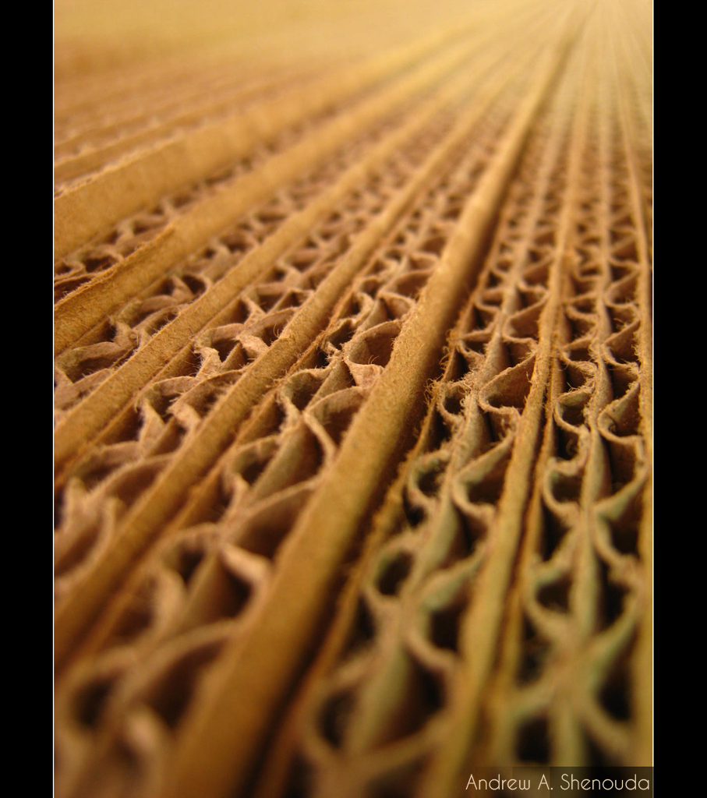
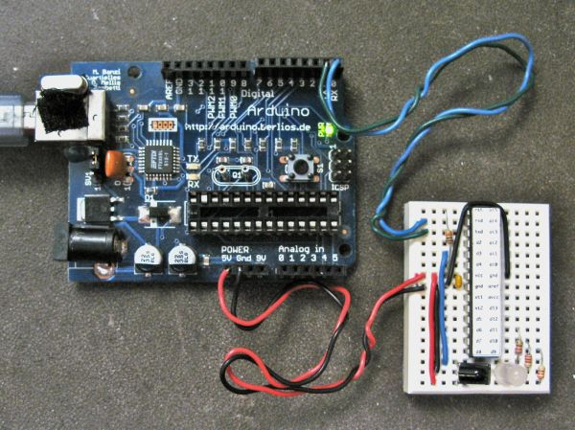
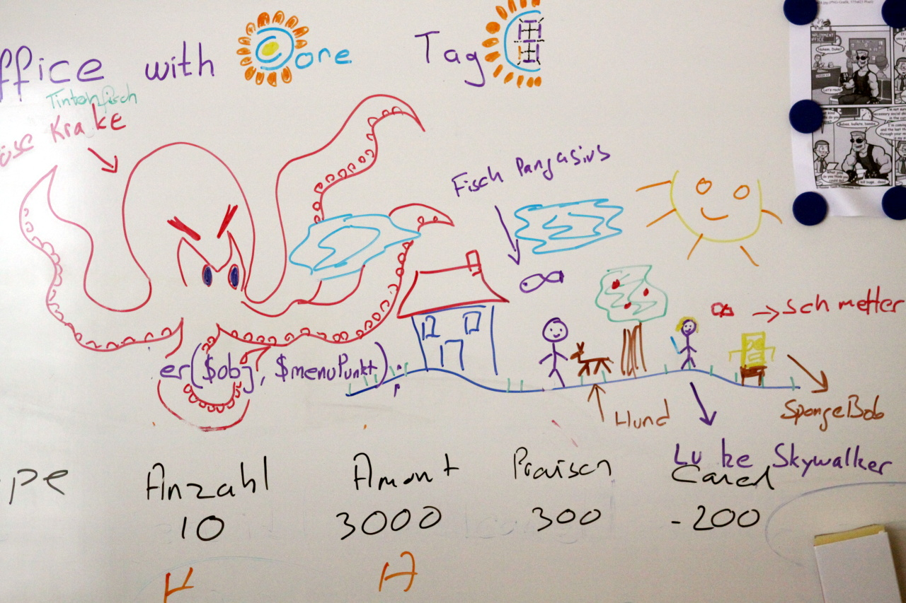
Ethical/Environmental Considerations
Materials
Manufacturing
Concerns
Wood/Cardboard
Mostly ethical
Whiteboard
"Cardboard Fibers" by Bakar_88 is licensed under CC BY 2.0. To view a copy of this license, visit https://creativecommons.org/licenses/by/2.0/?ref=openverse.
"Minimal Arduino" by todbot is licensed under CC BY-NC 2.0. To view a copy of this license, visit https://creativecommons.org/licenses/by-nc/2.0/?ref=openverse.
"Office Whiteboard" by pasukaru76 is marked with CC0 1.0. To view the terms, visit https://creativecommons.org/publicdomain/zero/1.0/?ref=openverse.
Notes:
ashley

Slide 10
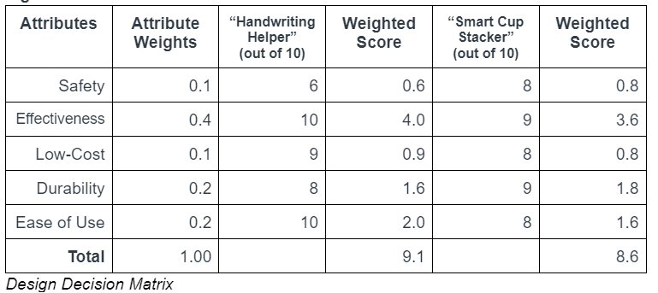
Design Justifications
Summary:
Aids in child handwriting development
Easy to determine functionality of toy
Durable and easy to make at a low cost
Safe to use
Notes:
ashley

Slide 11
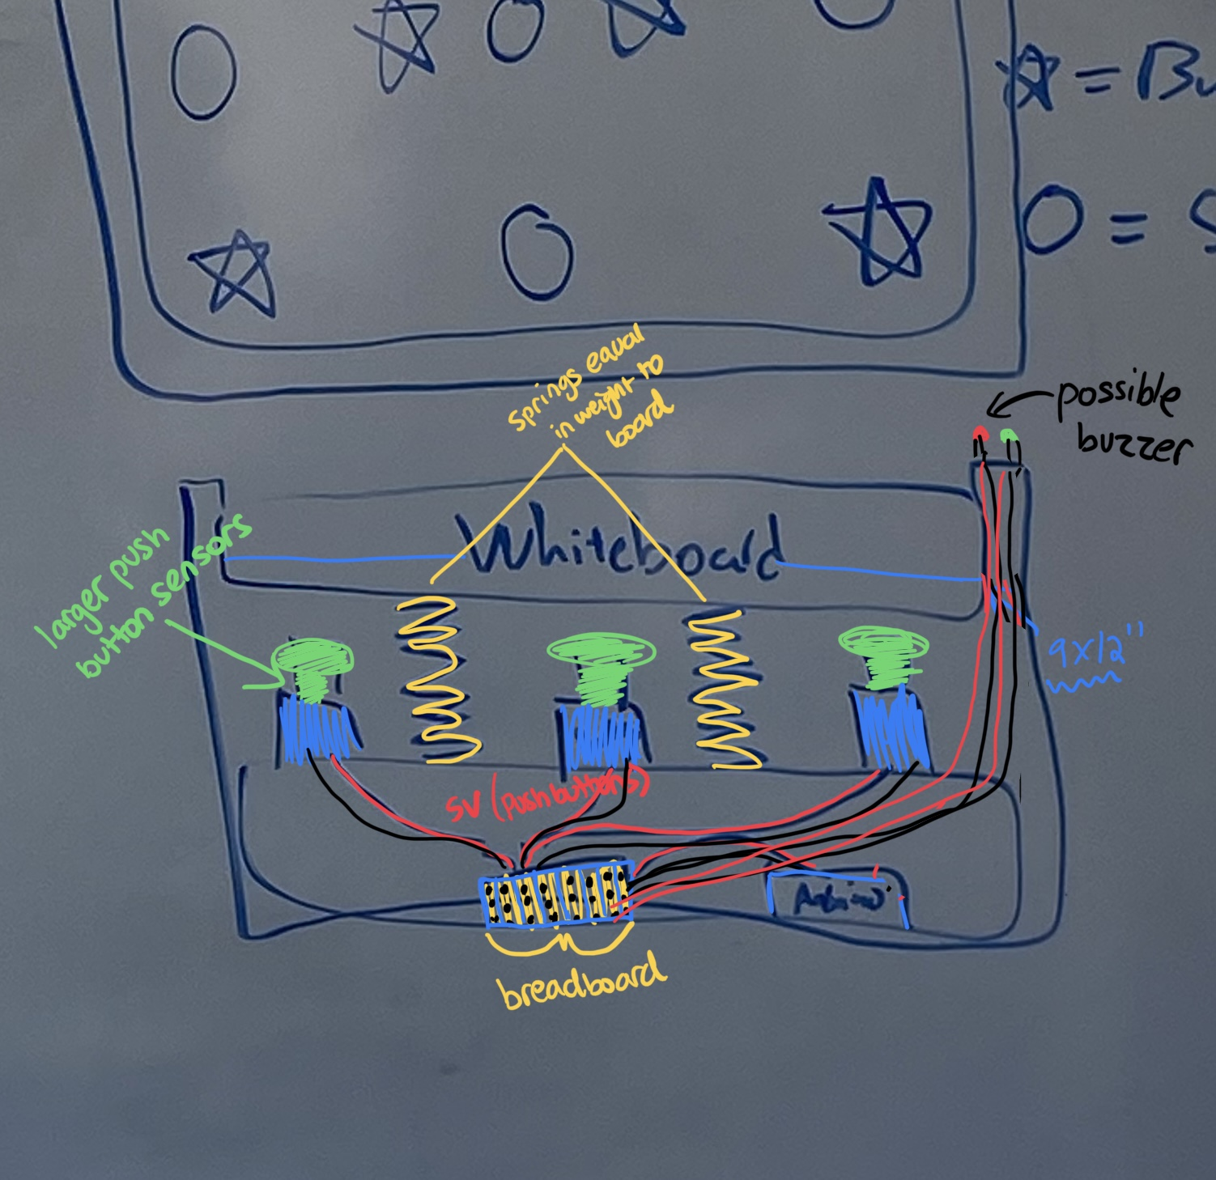
Design Process
Concept sketches
3D parts
Arduino
Research end user
Brainstorm ideas
Decide on idea (justifications)
Notes:
ashley

Slide 12

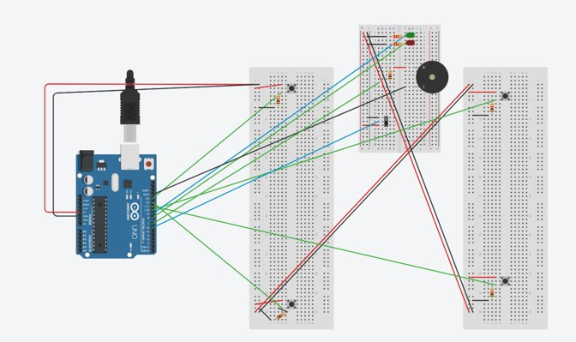
Tinkercad Circuits
SlidesCarnival for the prsentation template
Pexels for the photos
Notes:
johnathan

Slide 13
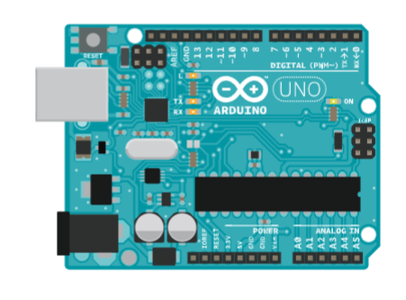
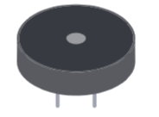
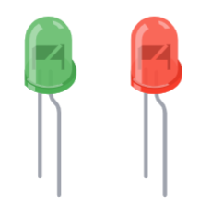

1 Arduino Uno
1 Piezo Sensor
1 Red LED and 1 Green LED
4 Push Buttons
Fitzgerald, S. (n.d.). Arduino Projects Book. Electronics in Touch Co. Retrieved April 18, 2023, from https://www.eitkw.com/wp-content/uploads/2020/03/Arduino_Projects_Book.pdf
Notes:
johnathan

Slide 14
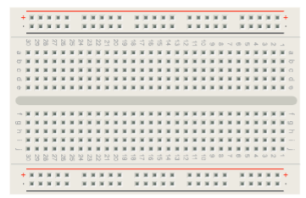
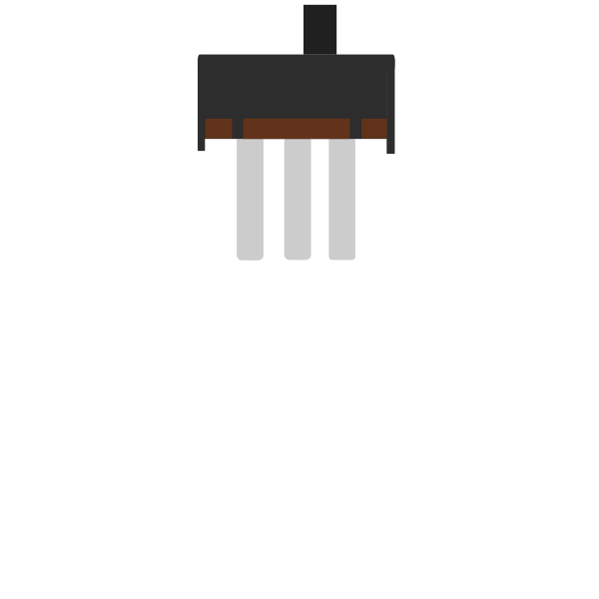
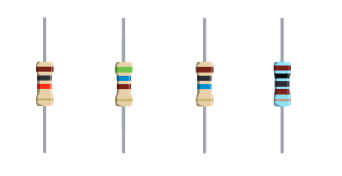
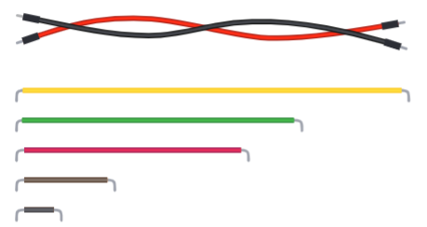
3 Breadboards
1 slide switch
4 1kΩ and 2 220Ω Resistors
Jumper Wires
Fitzgerald, S. (n.d.). Arduino Projects Book. Electronics in Touch Co. Retrieved April 18, 2023, from https://www.eitkw.com/wp-content/uploads/2020/03/Arduino_Projects_Book.pdf
Notes:
johnathan

Slide 15
Code Flowchart
Begin Program
// C++ code
// set ups the pins
void setup()
{
pinMode(6, INPUT);
pinMode(9, OUTPUT);
pinMode(8, OUTPUT);
pinMode(13, INPUT);
pinMode(7, OUTPUT);
pinMode(12, INPUT);
pinMode(11, INPUT);
pinMode(10, INPUT);
}
void loop()
{
// the if statement that depends on the slide switch
if (digitalRead(6) == HIGH) {
digitalWrite(9, HIGH); // green light on
digitalWrite(8, LOW); // red light off
// four if statements, one for each button
if (digitalRead(13) == HIGH) {
digitalWrite(9, LOW); // green light off
digitalWrite(8, HIGH); // red light on
tone(7, 420, 200); // play tone 80 (C5 = 523 Hz)
}
if (digitalRead(12) == HIGH) {
digitalWrite(9, LOW); // green light off
digitalWrite(8, HIGH); // red light on
tone(7, 420, 200); // play tone 60 (C5 = 523 Hz)
}
if (digitalRead(11) == HIGH) {
digitalWrite(9, LOW); // green light off
digitalWrite(8, HIGH); // red light on
tone(7, 420, 200); // play tone 60 (C5 = 523 Hz)
}
if (digitalRead(10) == HIGH) {
digitalWrite(9, LOW); // green light off
digitalWrite(8, HIGH); // red light on
tone(7, 420, 200); // play tone 60 (C5 = 523 Hz)
}
} else {
digitalWrite(9, LOW); // green light off (red light also off)
}
delay(10); // Delay a little bit to improve simulation performance
}
Define Arduino Pins
Inputs: 6, 13, 12, 11, 10
Outputs: 9, 8, 7
Green LED on
Red LED off
Is slide switch on?
High signal -> pin 9
Low signal -> pin 8
YES
NO
Low signal -> pin 9
Is one of the buttons pressed?
NO
Wait 10ms
YES
Low signal -> pin 9
High signal -> pin 8
Play tone 60
Green LED off
Red LED on
Piezo plays tone
Notes:
annie

Slide 16
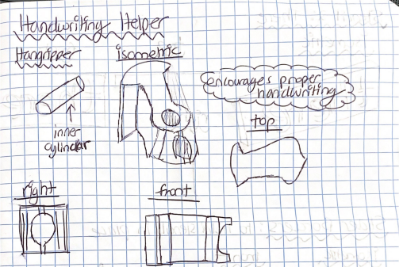
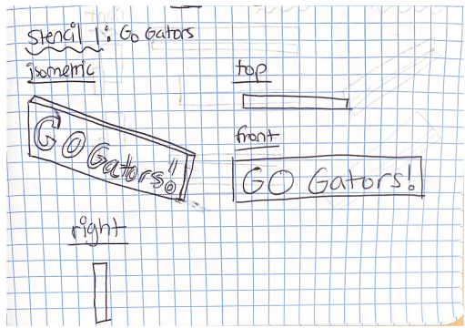
Solid Modeled Parts
Pencil Gripper
Stencil: Go Gators!
Notes:
lily

Slide 17
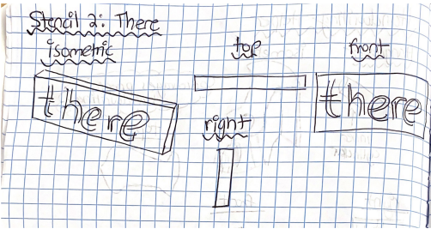
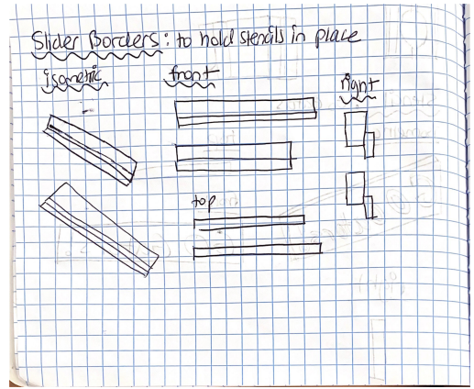
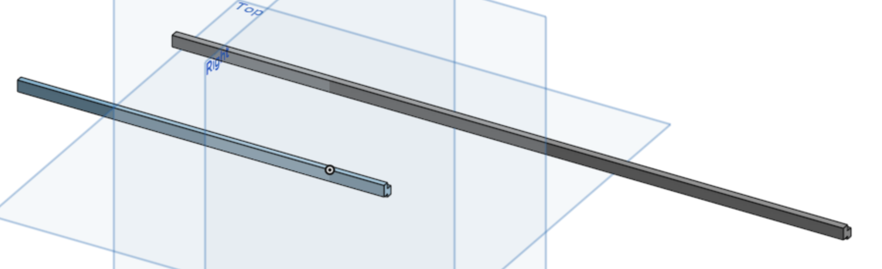
Solid Modeled Parts
there stencil
Stencil Holders
Notes:
lily

Slide 18


Design Limitations
Whiteboard and buttons
3D printed parts- Handgripper
Portable
Durability
Waterproof
Springs
Optimal pressure
Notes:
annie

Slide 19

References
"Creative Child" by Jose Mediavilla is marked with Public Domain Mark 1.0. To view the terms, visit https://creativecommons.org/publicdomain/mark/1.0//?ref=openverse.
"DIG14026_074" by LBJLibraryNow is marked with Public Domain Mark 1.0. To view the terms, visit https://creativecommons.org/publicdomain/mark/1.0/?ref=openverse.
Koziatek, S. M., & Powell, N. J. (2003). Pencil Grips, legibility, and speed of fourth-graders’ writing in cursive. The American Journal of Occupational Therapy, 57(3), 284–288. https://doi.org/10.5014/ajot.57.3.284
(G. Moore, personal communication, March 15, 2023)
"A sad lonely child sits on her bed, anxiety, illustration" is licensed under CC BY-NC 4.0. To view a copy of this license, visit https://creativecommons.org/licenses/by-nc/4.0/?ref=openverse.
"A-kid-drawing-or-writing" by dotmatchbox at flickr is licensed under CC BY-SA 2.0. To view a copy of this license, visit https://creativecommons.org/licenses/by-sa/2.0/?ref=openverse.
"Cardboard Fibers" by Bakar_88 is licensed under CC BY 2.0. To view a copy of this license, visit https://creativecommons.org/licenses/by/2.0/?ref=openverse.
"Minimal Arduino" by todbot is licensed under CC BY-NC 2.0. To view a copy of this license, visit https://creativecommons.org/licenses/by-nc/2.0/?ref=openverse.
"Office Whiteboard" by pasukaru76 is marked with CC0 1.0. To view the terms, visit https://creativecommons.org/publicdomain/zero/1.0/?ref=openverse.
Fitzgerald, S. (n.d.). Arduino Projects Book. Electronics in Touch Co. Retrieved April 18, 2023, from https://www.eitkw.com/wp-content/uploads/2020/03/Arduino_Projects_Book.pdf
"_MG_2511" by Naive Photography is licensed under CC BY-NC-ND 2.0. To view a copy of this license, visit https://creativecommons.org/licenses/by-nc-nd/2.0/?ref=openverse.
Long Before the Third Grade Test" by wecometolearn is licensed under CC BY 2.0. To view a copy of this license, visit https://creativecommons.org/licenses/by/2.0/?ref=openverse.
"1-Jpeg-dennis-sharon-January 20, 2009-85 mm" by Dr.J.S is licensed under CC BY-NC-ND 2.0. To view a copy of this license, visit https://creativecommons.org/licenses/by-nd-nc/2.0/jp/?ref=openverse.
"second grade writing class" by woodleywonderworks is licensed under CC BY 2.0. To view a copy of this license, visit https://creativecommons.org/licenses/by/2.0/?ref=openverse.

Slide 20


Thank you!!!!

